Slide 1
Fuelmart & Subway Safety Committee Meeting Wednesday, April 22, 2020 2:00pm Eastern Corporate Office Conference Room and Zoom Meeting Web Conference

Slide 2
March 18, 2020 Review
Coronavirus/Covid-19 Safety Reminders:
Avoid direct contact with other, cough/sneeze into your elbow, frequently wash or sanitize your hands, avoid touching your face and stay home if you are sick.

Slide 3
Incidents and Injuries from 3.18.20 to 4.22.20

Slide 4
3.18.20 FM 767
Driver of a pickup struck the main entrance pillar while attempting to park. Upon speaking to the driver, he had recently had surgery on his leg and this was his first attempt at driving since.

Slide 5
3.19.20 FM 767
While driving across the property a Ports company vehicle was struck by a pickup that pulled away from the pumps t-boning the company car. The airbags deployed and the vehicle had to be towed from the property. No injuries reported.

Slide 6
3.19.20 FM 767
Subway delivery driver, Avalon Transportation, struck the concrete parking spot barrier.

Slide 7
3.21.20 FM 626 Employee report of a customer drive off with nozzle still in the car. Breakaway worked as intended. No damages. 3.25.20 FM 626 Fuel Driver indicated the cap was broken on the NL 87 tank.

Slide 8
FM 783
4.02.20 reported a concrete post had been struck by the vehicle entrance. No one had reported an incident. It is not known when the incident happened
FM 641
4.04.20 At approximately 4:30am the driver of a CR England attempted to maneuver his truck in the diesel exit causing the trailer to strike the post. This incident was witnessed and reported by a FuelMart employee. Incident was also caught on multiple cameras at 641. *Discuss reporting procedures
FM 626
4.04.20 Customer struck yellow U-shaped bollard at pump 2. Damage was limited to chipped paint.
FM 787
4.05.20 Customer tripped on a rug and fell. No injuries reported. No information given by customer.

Slide 9
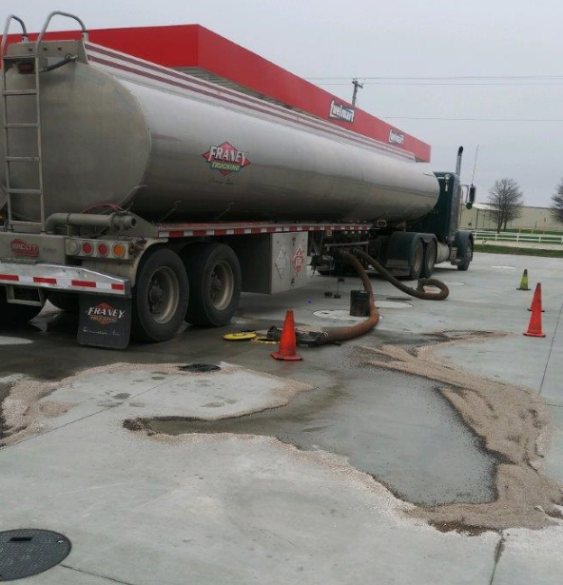
FM 787
4.5.20 Tom Franey Trucking delivery driver, while offloading, claimed the hose jumped and the FM brass collar cam off the hydrant creating this minor spill (see pic). It was initially thought to be an issue with the brass collar, upon viewing the pictures it was later determined that the driver failed to properly vent the tank.
FM 787
4.6.20 Vender’s vehicle leaked approx. ½ gal hydraulic fluid onto the new concrete.
FM 645
4.13.20 Customer was sitting inside his vehicle while fueling and the nozzle did not shut off resulting in a gasoline spill. There have been no other issues with the nozzle.

Slide 10
Employee Injuries Reporting Procedures

Slide 11
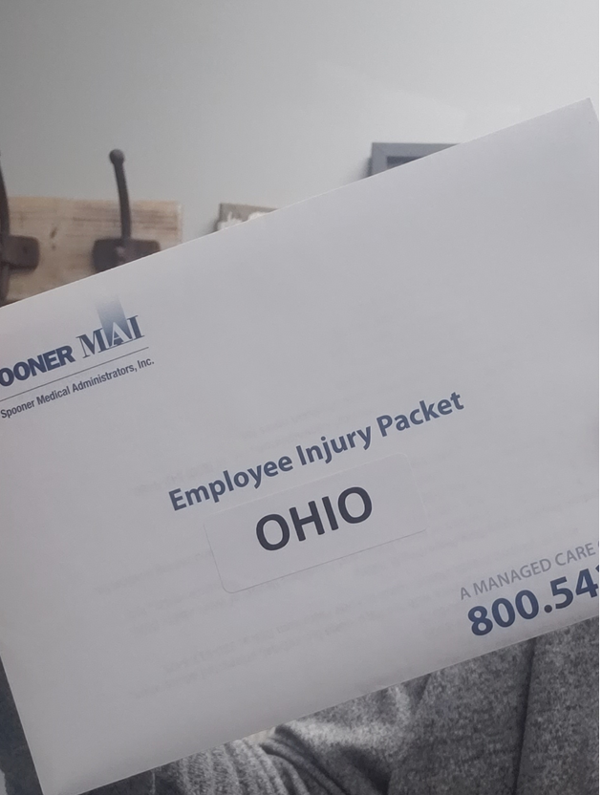
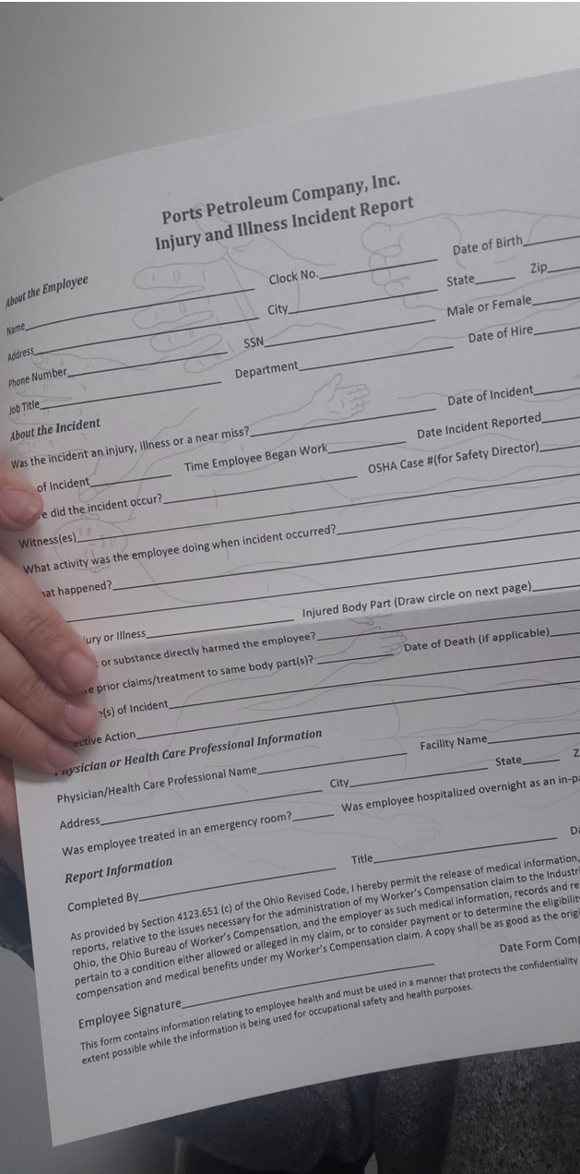
In the event of an employee injury please see the packet, left, inside the Employee Injury Packet, center, you will find the Injury and Illness Incident Report, right. Please see that all employees are using this form. We are seeing an increased number of employees using “incident” form which is for everything except employee injuries.

Slide 12
FM 701
4.1.20 Employee on a ladder twisting while putting product on a shelf fell off of the ladder due to the ladder shifting. Employee landed on some boxes, their leg hit the floor. Employee indicated a twisted ankle. No medical treatment.
FM 787
4.1.20 Hand laceration. While washing dishes the employee indicated the hole in the bottom of the breading pan has sharp edges. (Chester’s)

Slide 13
3.25.20 FM 645 Employee using a box cutter reported the blade slipped causing their arm to come down hard resulting in the cutter slicing their leg. Employee said they were not cutting away from themselves. *Teachable moment. Share this incident with your co-workers as a reminder to slow down and think about what you are doing. This could have easily been avoided 4.14.20 FM 787 Chester’s Employee was removing chicken from the fryer, accidently touched the fryer with forearm, resulting in a minor burn.

Slide 14
Date Range: Jan. 01, 2020 – April 21, 2020 Company Total Incidents: 55 - Incident every 2 days (increase of 22 incidents) FuelMart & Subway Total Incidents: 39 (increase of 15 incidents) FuelMart & Subway employee injuries Reported: 7 (increase of 4) (Two incidents struck in eye, three lacerations, one fall from ladder and one burn)
FuelMart Property Damage and/or Vehicle Incidents: 15 (increase of 7) FuelMart Customer Spills: 14 (increase of 3) (9 spills at fuel pumps) FuelMart & Subway Customer Injuries Reported: 2 (increase of 1)
Other Incidents: 1 (heart attack)

Slide 15
Severe Weather Presentation: Presented by Helen and Daelyn of FM 783

Slide 16
Severe Weather
- Tornados - Extreme Winds - Power Outages
- Thunderstorms - Do’s/Don’ts

Slide 17
DO NOT - put your life at risk to tend to certain outdoor activities during a storm, it can wait, your life is not worth risking!
DO NOT - touch or go near any downed power lines, always call the electric company and police department.
DO NOT - wait till the last second to take cover, it only takes seconds for a tornado to form and touch ground.
DO NOT - underestimate any storms.

Slide 18
DO - familiarize yourself with the map layout for emergencies.
DO - keep an emergency kit on hand.
DO - practice drills regularly
DO - keep up with weather activity even in off season times.
DO - research and learn what you can to keep yourself prepared.

Slide 19
Emergency Kits
Batteries + backup batteries
Flashlights
Weather Radio
First aid kits
Whistle
Emergency kits are recommend to have all these items as well as at least a 24hr supply of food, medicine, and anything else that may be needed if stuck in the building till help arrives.

Slide 20
Severe weather can happen at any given time, over the years the weather has drastically changed and severe weather has occurred even during the off season. Many people think that just because the “season” is over means they are safe, this is not the case.
Today we will discuss what to do in case of severe weather, whether during season or out of season.

Slide 21
Tornados are vertical funnels of rapidly spinning air. The winds may top up to 250mph and can clear a pathway a mile wide and 50 miles long.
Also known as twisters, tornados are born in thunderstorms and are often accompanied by hail. Supercells are giant persistent thunderstorms that spawn the must destructive tornados.

Slide 22
2019 tornados
Indiana - 39
Ohio - 59
Illinois - 37
South Dakota - 23
All of these ranging from an f1 - f5. Overall there was a total of 1,520.

Slide 23
Tornado Safety
During any type of storms it is a very good idea to keep your radio tuned to a station that will alert to any incoming weather alerts, this will also alert to possible tornado activity.
During a tornado, please seak cover, each facility should have a map with where they should seak shelter.
During the next week each facility should take the time to practice a drill with each shift, so in the event something happens they will be prepared.

Slide 24
Severe Thunderstorms
Please refrain from going outside when it is lightning.
It is advisable to stay clear of windows due to strong winds, hail and possible flying debris.
Keep a flashlight on hand and some form of radio/phone in case power goes out so you can keep alerts coming in.
If you haven’t done so prior to bad weather take empty washer fluid bottles and fill them with water and put in outside trash cans. This can help keep them from moving.
When it is safe to do so, survey the area for downed lines, debris, or anything that could be a hazard and alert proper authorities.

Slide 25
Power Outages
Make sure during this time only employees are in the store. Power out = more safety risks.
Once a month check to make sure your doors are properly working and locking correctly.
Keep a flashlight on you, as well as communication of some form.
Be mindful of your surroundings, it’s easy to trip on items unseen so be sure to keep things clear of walk ways.

Slide 26
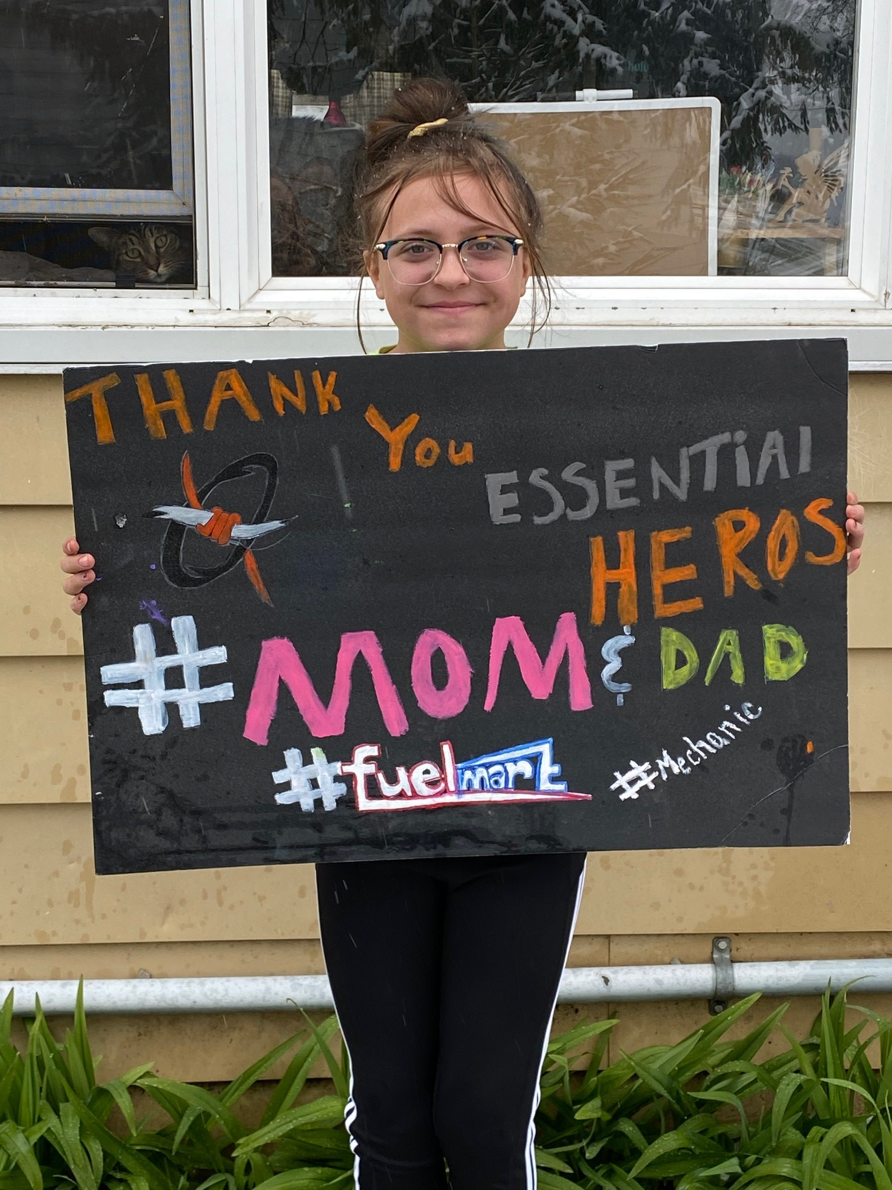
Ports Family,
This is a picture of Shelby holding a sign she made for her mom and dad. Her mom Sara is our Complex Manager at unit 767 in Bradner, Ohio.
Shelby,
Thanks for making the sign and recognizing your mom, dad and the rest of the essential workers at Fuelmart.
I’m sorry that you even have to know what essential workers means. We appreciate your mom and dad Chico a lot.
The sign made my day.
You’re the Best !!
Haley

Slide 27
Open Floor for Safety concerns & Suggestions

Slide 28
Safety Topic – turning your incident experiences into training tools: presented by Angie Tarvin FM 648
Next month’s Meeting is May 13th at 2pm

